Slide 1


MONITORING MACHINERY VIBRATION USING DYNAMIC AND PROCESS CONTROL SIGNALS
LEVEL 2 – LESSON 3

Slide 2

OBJECTIVES
After completing this training module you will understand:
The difference between a dynamic signal and a process control signal
The strengths and limitations of each type of signal
How to use dynamic signal and process control signal together in some instances to offer an optimal level of protection for critical machinery

Slide 3
TRADITIONAL VIBRATION MONITORING
Overview:
Used to monitor machinery vibration using specialized analyzers.
Sensors send dynamic signals (mV output of time waveform) to analyzers.
Analyzers convert waveforms to FFT, showing amplitudes of individual frequencies.
Methods:
Online Monitoring Systems: Continuously poll measurement points.
Portable Data Collectors: Used for periodic measurements.
Alarm Methods:
Establish baseline for normal machinery operation.
Yellow Alarm: Indicates increased vibration; further analysis needed.
Red Alarm: Indicates high vibration; risk of catastrophic failure, may trigger shutdown.
Alarm Techniques:
Trending: Overall/peak values, crest factor.
Time Waveform Values: Peak, peak-to-peak.
FFT Monitoring: Masking, banding, enveloping.

Slide 4
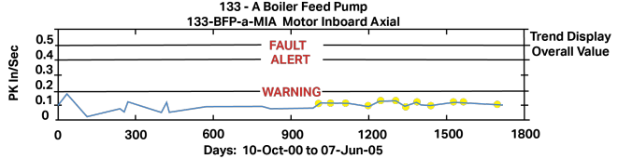
VIBRATION MONITORING – TRENDING
Overall Value, Peak Value, Crest Factor
Trend Display:
Recorded over 5 years.
Warning, alert, and fault alarms set but never exceeded.
Alarm Trends:
Overall Value
Peak Value
Crest Factor
Key Points:
Useful for general vibration level alarms.
Individual fault frequencies can be overshadowed or ignored by changes in other frequencies' amplitudes.

Slide 5
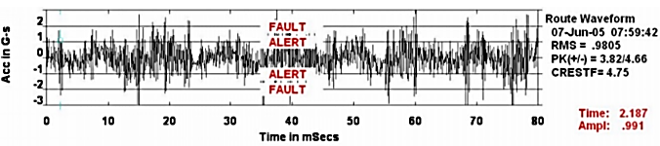
VIBRATION MONITORING – TIME WAVEFORM
Peak, or Peak to Peak Values
Time Waveform Alarms
Alarm Types:
  Peak Values
  Peak-to-Peak Values
Characteristics:
  Instantaneous alarms.
  Exceeding "alert" and "fault" limits indicates issues.
Key Points:
  Specific fault frequencies (e.g., bearing faults) can be overshadowed by lower
  frequency, higher amplitude vibrations.
  Effective for detecting lower frequency transients and impacts.

Slide 6
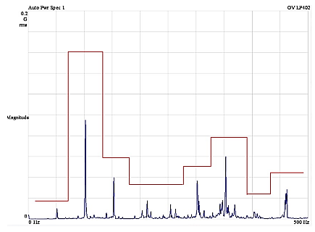
VIBRATION MONITORING – FFT
Masking / Banding / Enveloping
In this FFT, a process of Masking, Banding, or Enveloping specific frequency regions is being used.
This method works very well when you want to have different alarm levels at different frequency ranges so that you can monitor for specific faults.

Slide 7

Traditional Vibration Monitoring
Online Monitoring:
  Historically required specialized vibration instrumentation.
  Modern methods use 4-20 mA current loops with existing PLCs or DCS systems.
  Leverages existing systems in industrial plants to generate vibration alarms.
Portable Data Collection:
  Provides flexibility for periodic measurements and analysis.

Slide 8
TRADITIONAL CONCEPTS – ADDED VALUE OF PROCESS CONTROL
Process Control Signals (e.g., 4-20 mA):
Protect critical applications
Guard against rapid or dramatic failures
Monitor remote applications with no operators
Benefits:
PLC/DCS systems continuously monitor for catastrophic failures
Analysts receive timely alarms for potential issues
More focus on analysis, less on emergency responses
Reduced risk of failure due to operator error or environmental issues

Slide 9
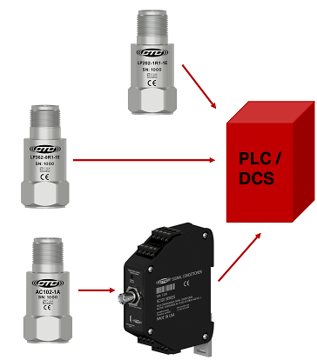



PROCESS CONTROL – FOR PLCs OR DCS SYSTEMS
4-20 mA Signal Sources:
Loop Power Sensor
Dual Output Loop Power Sensor (4-20 mA and temperature output)
Transmitter (converts mV dynamic signal to mA signal)

Slide 10
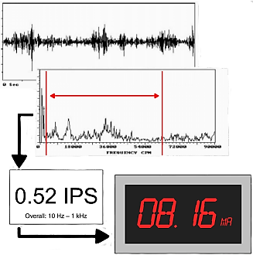
TRADITIONAL CONCEPTS – HOW DOES IT WORK?
4-20 mA Loop Power Sensor
Signal Range: 4 mA (no vibration) to 20 mA (max vibration load)
Output Proportionality: Current signal proportional to vibration amplitude within a defined frequency band
Frequency Band: Includes all vibration data within the band, excluding frequencies outside the band

Slide 11
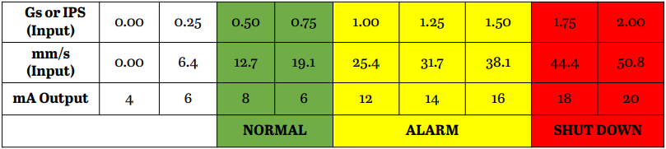
PROCESS CONTROL – PROCESS SCALING
Scaling for 4-20 mA Loop Power Sensor
Normal Conditions: 8-10 mA output
Alarm Limits: 12-16 mA
Shutdown Limits: 18-20 mA
Amplitude: Based on selected frequency band
For a worksheet to set your scale measurement range, visit CTC Online.

Slide 12
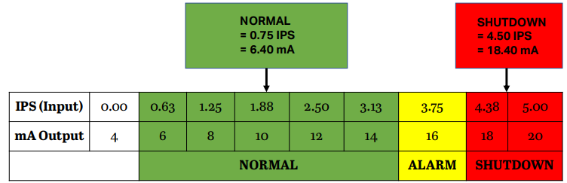
PROCESS CONTROL – PROCESS SCALING
In some cases a broader than normal scale may be desired when a significant increase in vibration above normal can be tolerated before alarm and shutdown would be required.
For example, your application might operate normally at 0.75 IPS and varying loads might make higher overall levels a normal occurrence that would not merit an alarm. Instead, alarms and shutdown might not be desired until 4.5 IPS.

Slide 13

PROCESS CONTROL – LOOP POWER SENSOR: 4-20 mA
Loop power sensors are normally available in acceleration or velocity output. Acceleration output will give the higher frequencies more proportional value in the overall amplitude relative to a comparably specified velocity output sensor.
The acceleration or velocity units can be expressed as Peak or RMS values. Generally speaking, Peak will provide more information about transient variations, while RMS (which essentially averages the peaks) will give less attention to transients.
The frequency ranges for loop power sensors are generally available in two fixed bands, such as: q 10 – 1000 Hz (600 – 60,000 CPM) q 3 – 2500 Hz (180 – 150,000 CPM)
Loop power sensors are great for trending and alarming the overall vibration. Just remember, that since there is no dynamic output from this sensor, there is also no time waveform or FFT, and therefor is not intended for diagnosing what the alarm might be caused by.

Slide 14
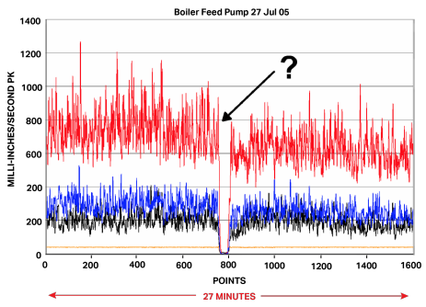
PROCESS CONTROL – VIBRATION DATA
This is a 27-minute trend of process vibration data from a 600 HP Boiler Feed Pump.
Initially, it looks as if the power failed on all four of the vibration sensors, creating the zero output in the center of the display.
How can this be analyzed?
What do you think we should start looking for as a cause for the loss of data?
Could this be a powering issue with our PLC or sensors?

Slide 15
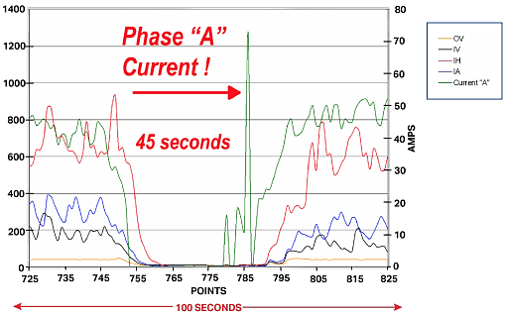
PROCESS CONTROL – VIBRATION DATA WITH MOTOR CURRENT
Observation: Motor current dropped to zero.
Insight: Motor was accidentally shut off for 45 seconds.
Solution: Focus on coaching end-user rather than troubleshooting sensors.
Lesson: Integrating process control data helps provide a comprehensive analysis.

Slide 16
Blended Approach – Best of Both Worlds
Combining dynamic vibration sensors with vibration transmitters for dual signal output (4-20 mA & dynamic):
Continuous Monitoring: Through PLC/DCS system
Alarming: For catastrophic failures via PLC/DCS
Diagnostic Analysis: For specific fault frequencies using dynamic signal analyzers
Data Access: Permanent sensors speed up route collection and enhance safety
Efficient Analysis: Analysts focus on critical data, not healthy equipment
Team Protection: Collaborative approach enhances machinery and plant health

Slide 17
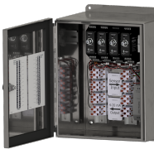
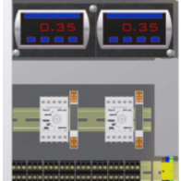
BLENDED APPROACH – DYNAMIC SENSOR AND TRANSMITTER
Signal Conversion:
Dynamic sensor signal → mV signal → 4-20 mA output by transmitter
Monitored by PLC/DCS alongside other process data
Benefits:
Dynamic signal access for fault diagnosis and trend analysis
Buffered output and pass-through options for flexible data access
Greater filter flexibility to target specific alarms
Versatile Configurations:
Relays: Shutdown machinery on high vibration
Digital Displays: Show scaled/actual vibration levels
Alarms: Visual/auditory alerts
Retransmission: Process control signal to PLC/DCS

Slide 18
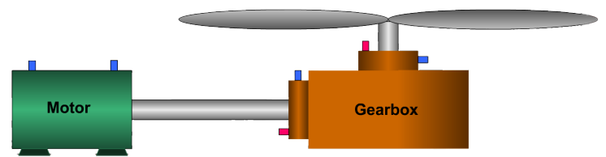
BLENDED APPROACH – COOLING TOWER APPLICATION
A good example of protecting equipment or processes using diagnostic and process control signals is a cooling tower application where the gearbox has been the primary source of problems:
Dual output sensors (red) – on the input and output shafts of the gearbox
mV/g sensors (blue) on all bearings
This allows analysts to trend for bearing faults and alarm for imbalance or gear noise

Slide 19
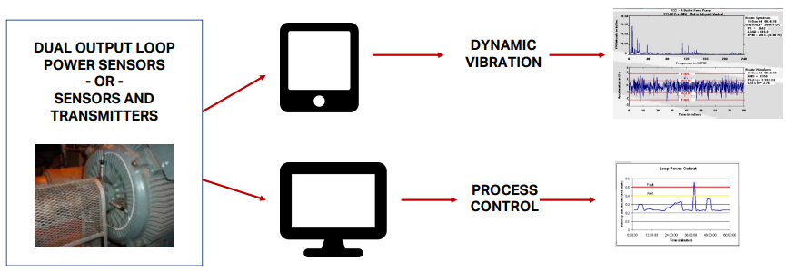
PROCESS CONTROL – INTEGRATION
Integrating dynamic vibration with process control can make a very successful program for monitoring your machines!

Slide 20
Thank you!
If you have any questions?
Contact us at:
sales@GTI.xyz
+92-xxxxxxxxx

